Slide 1
UPF Regressor and Classifier Designing using Random Forest Observations
By
Kathakoli Sengupta

Slide 2
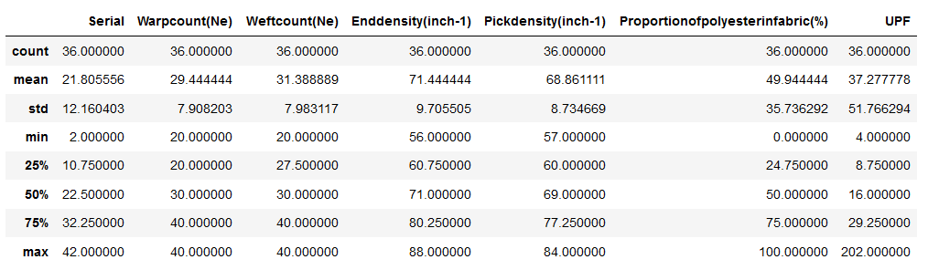

Data Description
Data Shape :

Slide 3
Data Visualisation

Slide 4
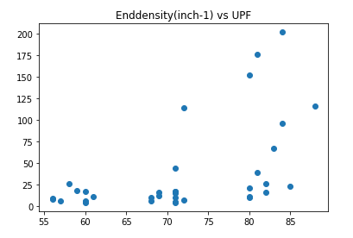
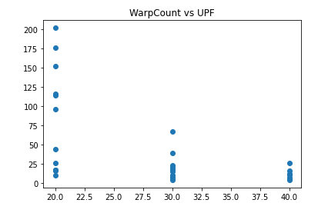
Warp Count vs UPF
End Density vs UPF

Slide 5
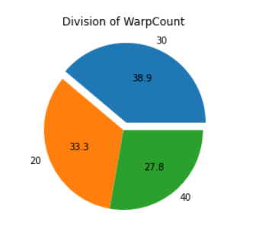
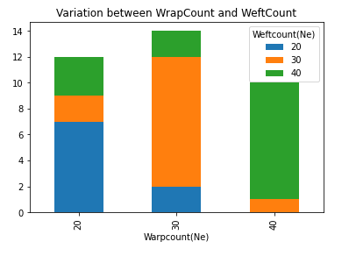
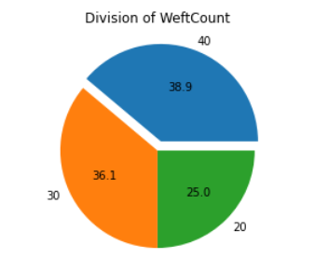
Variation between Warp Count and Weft Count

Slide 6
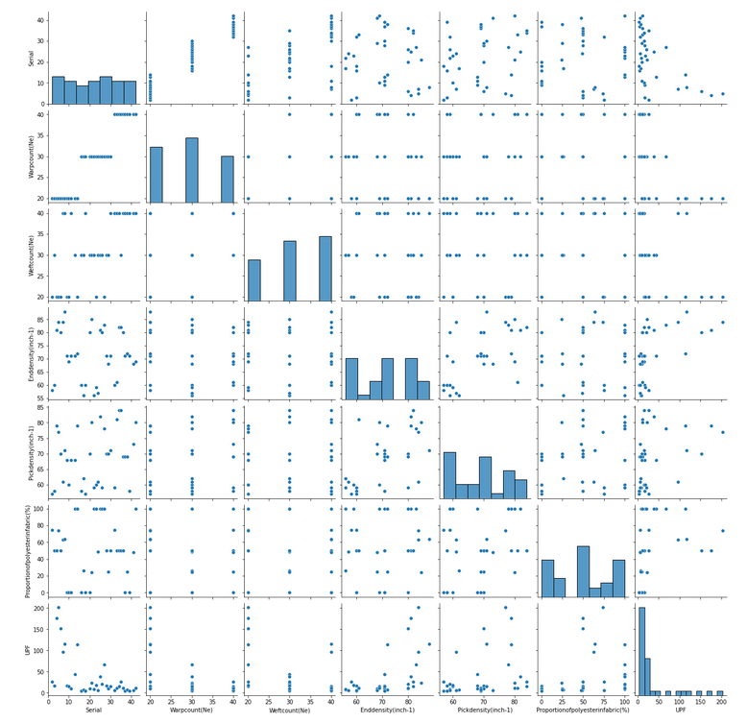
Complete Pairplot

Slide 7
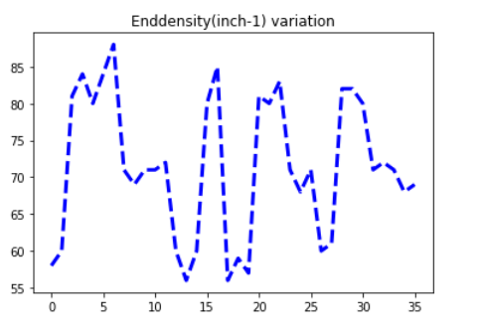
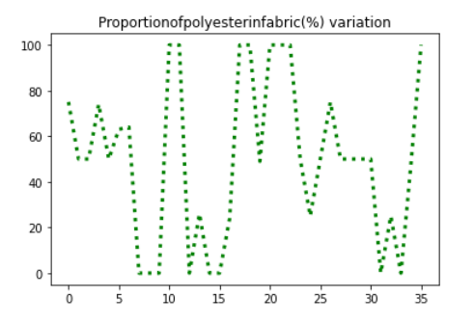
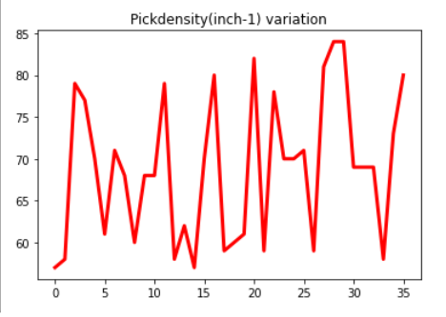
Trend Plots

Slide 8
Random Forest Regressor

Slide 9
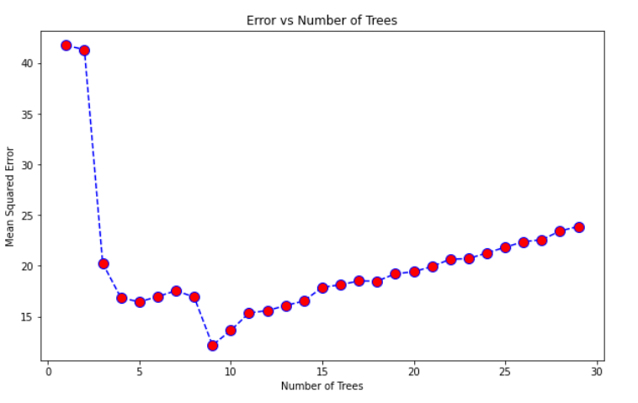
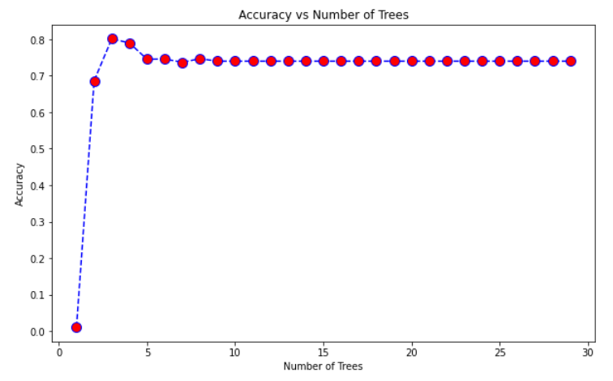
Conclusion : The error in the model is minimum for 9 trees is 12.18%.
Conclusion : The accuracy of the model is maximum for tree depth= 3 is 80.13%.

Slide 10
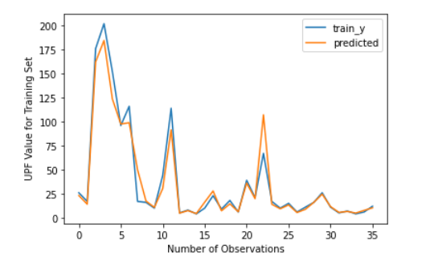
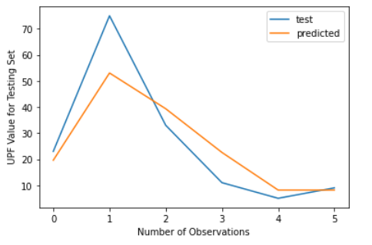


Train labelled output and predicted output
Test labelled output and predicted output
Correlation Matrix
Correlation Matrix

Slide 11

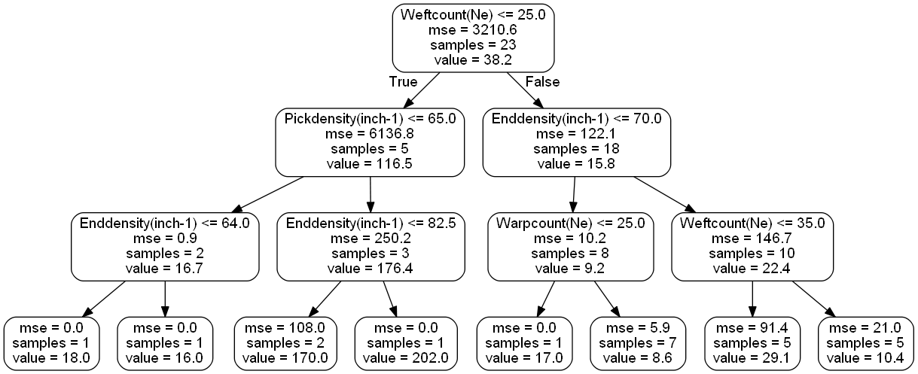
Random Forest Accuracy Parameters

Slide 12
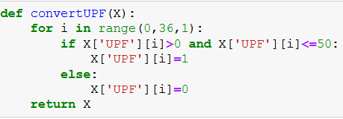
Random Forest Classifier
Class Division Criteria :
1 : bearable UPF(0-50)
0 : Harmful UPF(50-250)

Slide 13
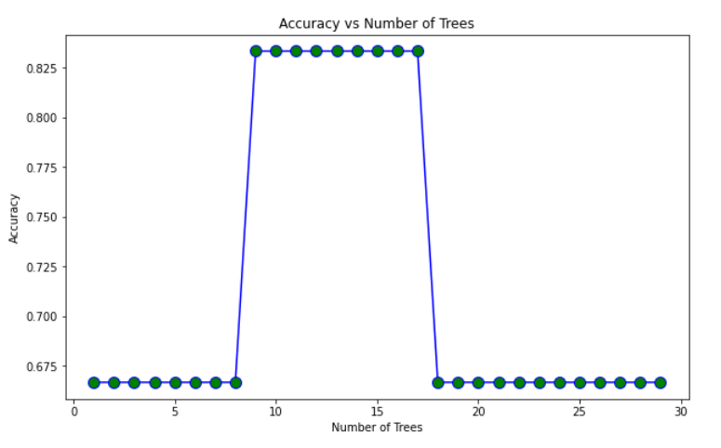
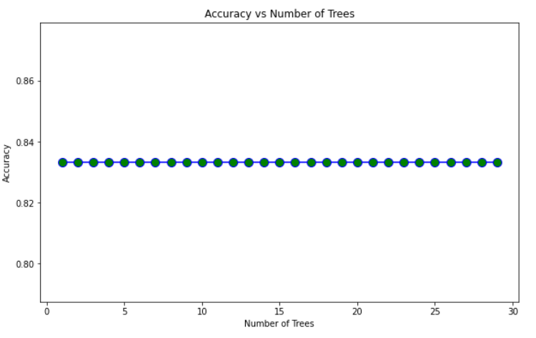
Conclusion : The accuracy of the model is maximum for number of tree= 9 is 83.33%.
Conclusion : The accuracy of the model is same for all tree depth is 83.33%.

Slide 14
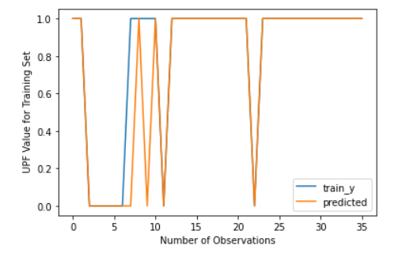
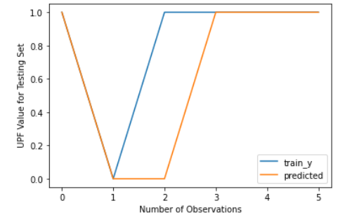
Train labelled output and predicted output
Test labelled output and predicted output
Interpretation : Only 2 values are wrongly predicted
Interpretation : Only 1 value is wrongly predicted

Slide 15
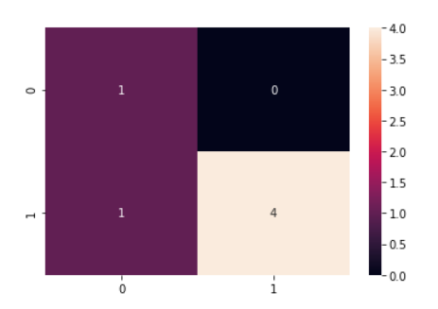
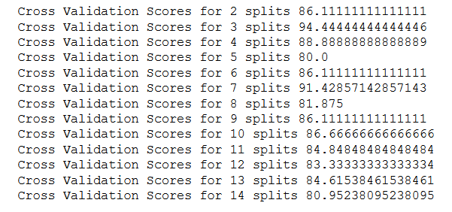

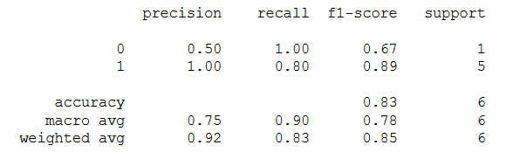
Confusion Matrix
Accuracy Parameters
Cross-Validation Scores :
The best cross-validation score is given for 3 splits =94.44%

Slide 16
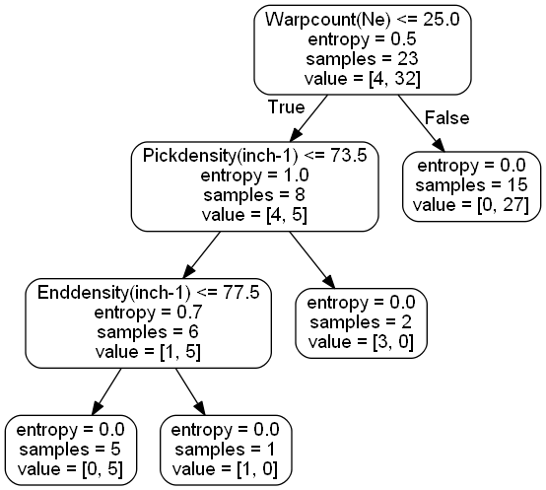
Random Forest Classifier Tree

